Slide 1
WILMS TUMOR
IN
WAGR SYNDROME

Slide 2
What Is WAGR syndrome?
WAGR syndrome is a rare genetic condition which includes
Wilms Tumor
Aniridia
Genital and urinary tract abnormalities
Range of developmental delays

Slide 3
What is Wilms tumor?
A form of kidney cancer
Occurs mostly in children
Also called “nephroblastoma”
WILMS TUMOR IN WAGR SYNDROME

Slide 4
Who is at risk for Wilms tumor?
Typical child
1 in 10,000
Child with WAGR syndrome
1 in 2
WILMS TUMOR IN WAGR SYNDROME

Slide 5
What causes Wilms tumor?
Immature cells in the kidney called nephrogenic rests
These cells are more common in children with
genetic disorders like WAGR syndrome
WILMS TUMOR IN WAGR SYNDROME

Slide 6
What are nephrogenic rests?
Immature cells in the kidney
Have the potential to develop into Wilms tumor
Clusters of these cells may look like Wilms tumor on ultrasound
WILMS TUMOR IN WAGR SYNDROME

Slide 7
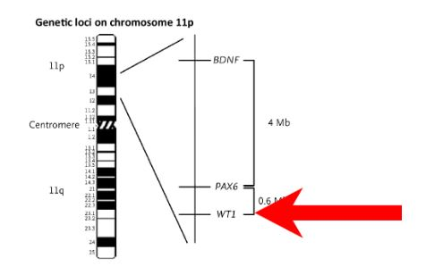
WT1: the Wilms tumor gene
Important for kidney development before birth and function throughout life
Mutation or deletion of this gene increases the risk for Wilms tumor
Chromosome 11
WT1 gene
WILMS TUMOR IN WAGR SYNDROME

Slide 8
How is Wilms tumor diagnosed?
Ultrasound imaging every 3 months beginning at birth/diagnosis of WAGR syndrome
If a mass is detected, additional imaging such as MRI or CT may be needed
Definitive diagnosis is made by examining the cells under a microscope
WILMS TUMOR IN WAGR SYNDROME

Slide 9
Nephrogenic rest or Wilms tumor?
Nephrogenic rests
Are very common in children with WAGR syndrome
Are benign (not cancer)
May or may not progress to Wilms tumor
May be present at the same time as Wilms tumor
Often hard to tell the difference on ultrasound or MRI
May require same treatment as Wilms tumor
WILMS TUMOR IN WAGR SYNDROME

Slide 10
Treatment
Treatment is tailored to the individual and may include
Surgery
Chemotherapy
Radiation therapy
WILMS TUMOR IN WAGR SYNDROME

Slide 11
Types of Surgery
Radical nephrectomy
Tumor, kidney, and ureter are removed
Partial nephrectomy
Only the tumor is removed
Biopsy
A tumor sample is removed to examine the cells under a microscope
WILMS TUMOR IN WAGR SYNDROME

Slide 12
Chemotherapy
Chemotherapy may be given
Before surgery
After surgery
Before and after surgery
A combination of drugs may be used, including
Actinomycin D (dactinomycin)
Vincristine
Adriamycin (doxorubicin)
WILMS TUMOR IN WAGR SYNDROME

Slide 13
Post-treatment Care
Long-term survival rates are high
Surveillance for Wilms tumor should continue throughout life
Guidelines for long-term follow-up care for childhood cancer survivors:
http://www.survivorshipguidelines.org
WILMS TUMOR IN WAGR SYNDROME

Slide 14
The IWSA is working with researchers around the world
to improve diagnosis and treatment
www.wagr.org
The mission of the International WAGR Syndrome Association is to promote awareness, stimulate research, and to support families affected by WAGR syndrome
WILMS TUMOR IN WAGR SYNDROME

